Slide 1
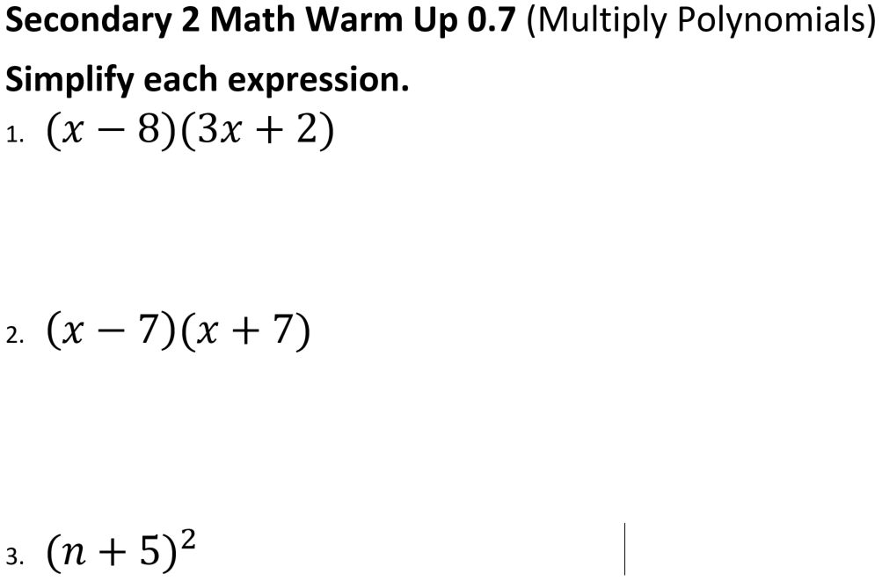

Slide 2
Secondary 2
lesson 0.8
Simplify, Add, and Subtract Radicals
Objective:
By the end of the lesson you will be able to:
Simplify Radicals
Add and Subtract Radicals
(Know when and how)

Slide 3
Parts of a Radical (square roots are a type of radical):

Slide 4
We can simplify some radicals in our heads because they are perfect squares or cubes.
Examples:
1. $\sqrt{64}$ 2.$\sqrt[3]{27}$ 3. $−\sqrt{49}$
4. $\sqrt{−16}$ 5.$\sqrt[3]{−8}$ 6. $\sqrt{x^{2}}$

Slide 5
Sometimes, radicals don't contain perfect squares or cubes, so we will have a radical left in the answer. To simplify these, we pull out everything we can, and leave the leftovers inside the radical.
For example, $\sqrt{20}=\sqrt{4∗5}=2\sqrt{5}$
We use what we call "factoring trees" to simplify these. Try to break the inside up into factors that are perfect squares (or cubes) times not perfect squares (or cubes), then simplify the perfect parts.

Slide 6
Examples: Simplify the radicals
7. $\sqrt{27}$ 8. $\sqrt{54x^{4}y^{5}z^{7}}$
9. $\sqrt[3]{54a^{3}b^{7}}$ 10. $\sqrt{60xy^{3}}$

Slide 7
Adding & Subtracting Radicals
When we add or subtract radicals, we ask ourselves "How many of this radical do we have?" We don't change the radical itself, we just add or subtract the coefficients out front of the radicals. We can only add identical radicals (we can't add the square root of 5 to the square root of 7 - we can only add a square root of 5 to another square root of 5).
Steps: 1. Simplify each term.
2. Combine the coefficients of like radicals.

Slide 10
$$Simplify: \sqrt{20}+\sqrt{45}$$

Slide 12
Landing our Big Ideas:
Addition: the nature of an item NEVER changes when you add or subtract.
Looking ahead - Multiply verses Addition: Always start by recognizing what the main operation in the problem is.
Simplify: Take everything you can out of the radical
Looking ahead - You can’t have a radical or an imaginary number in the denominator if a problem is simplified.

Slide 13
Journal Entry: How is combining radicals the same as combining fractions? (or terms of a polynomial?)
Assignment – Due next class:
Packet 0.8
and
0.8 Math XL

